Slide 1



TOPIC: WW2 Homework ideas for the Autumn Term
Imagine you are an evacuee. Design and write a postcard home to your family explaining what has happened to you.
Research rationing and write a menu using those ingredients. You could even make something and take photos.
Draw and explain what 6 things you would want to take with you if you were evacuated. Explain why you would take them.
Make a newspaper report of a bombing on your street.
Design a poster persuading people to join the army.
Create a timeline of events that occurred in World War 2. Include full sentences in your written work.
Research what school life was like for children who were living during WW2.
Research what the blackout was and the effect it had on people.
Make an Anderson Shelter. Include a set of instructions for how you made it.
Write a fictional diary as a child during WW2.
Research an aircraft, ship or tank that took part in WW2. Make a model, drawing or collage and don’t forget to include a description.
Make a small rag rug. Write a set of instructions for making it.
We will be learning about this topic until Christmas. Please send in one piece of homework each Thursday. If what you’re making/writing is taking 45 minutes a week but you want to continue over to the next week, then ask a parent/carer to write a note in your homework diary so as we can quickly see how your work is progressing. Remember PRESENTATION! Your work should reflect the time taken. Please upload your work to TEAMS. If there is a problem with this please speak to your class teacher.

Slide 2
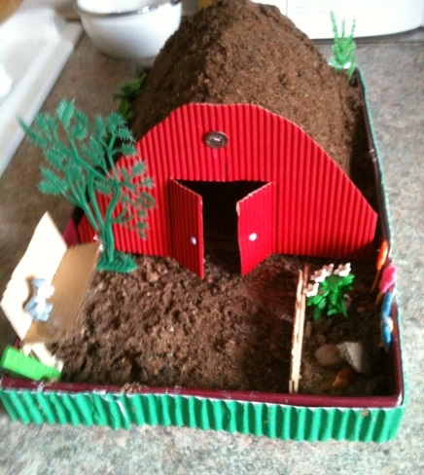
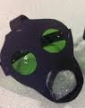
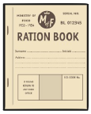
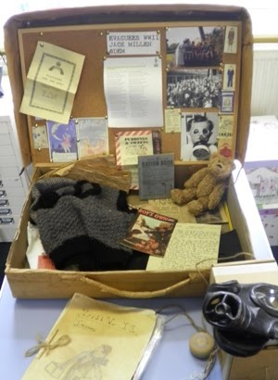

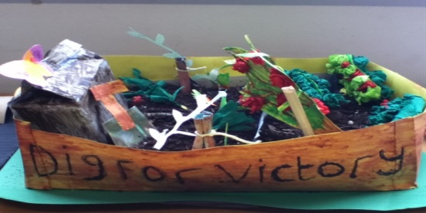
Write a script for a radio news broadcast about a key event during World War 2.
Write a song to keep people's spirits up during the war.
Write in role as a soldier to his family about life in the trenches.
Research how WW2 affected your local area.
Find out what ‘Dig for Victory’ was.
Research your family tree and find out which family members were alive in WW2. Can you find out anything else about them? Did any of them serve in the army?
Research & create fact files on key events e.g. Battle of Britain, the Blitz, VE day or D-Day.
Write a war based story / poem.
Visit a WW2 museum and write a diary / review about your trip e.g. Imperial War Museum, Canterbury Heritage Museum, Kent Battle of Britain Museum or the Spitfire and Hurricane Memorial Museum.

