Slide 1

KS2 SATs Presentation
Tanya Naylor, Deputy Head
Ben Jones, Year 6 Lead

Slide 2
^{Welcome, Parents!}
^{•End of KS2 Assessments 2025}
•What to expect from the KS2 tests.
•How you can support your child/children

Slide 3

About the tests (w/c 12th May 2025)
^{Monday:}
Punctuation and grammar (45 minutes)
^{Spelling (20 spellings)}
^{Tuesday:}
^{Reading (1 hour)}
^{Wednesday:}
^{Arithmetic (30 minutes)}
^{Reasoning Paper 1(40 minutes)}
^{Thursday:}
^{Reasoning Paper 2(40 minutes)}

Slide 4
^{Administration}
• Monday 12th May - Thursday 15th May
• Over 4 days Tests will be both set and
marked externally by a computer.
• Writing and Science will be Teacher Assessed.

Slide 5

The English tests
GPS
Grammar and Punctuation
Spelling
Reading Test
Comprehension

Slide 6
The Grammar and Punctuation Paper 1
45 minutes
Questions will refer to both children’s knowledge of grammatical terms (such as pronoun and conjunction) and use of language in the right context.
Some will require children to put in the appropriate punctuation marks to clauses or sentences or to use a particular sentence structure.

Slide 7
Example Questions
Starter question:
Write the contracted form of the underlined words:
• That decision does not seem fair.
Challenging question:
Circle all the determiners in the sentence below:
• Two apple trees screened the open windows on one side.

Slide 8
Paper 2 - Spelling test 15 minutes 20 words
Write the missing word into the gap.
Spellings will increase in difficulty as test progresses
Sara wanted to be an explorer and discover new lands.
• The spy was sent on a secret mission. Challenging words: Omar put the cutlery back in the drawer.
• Ellen’s gold bracelet was her most treasured possession.

Slide 9

Reading Test Paper
• 1hr in length • 3 separate passages of text.

Slide 10
There will be a selection of question types:
Ranking/ordering, e.g. ‘Number the events below to show the order in which they happen in the story’
Labelling, e.g. ‘Label the text to show the title of the story’
Find and copy, e.g. ‘Find and copy one word that suggests what the weather is like in the story’
Short constructed response, e.g. ‘What does the bear eat?’
Open-ended response, e.g. ‘Look at the sentence that begins Once upon a time. How does the writer increase the tension throughout this paragraph? Explain fully, referring to the text in your answer.’

Slide 11
More Example Questions
Retrieval question:
How much did the first space tourist pay to go into space?
Explanation question:
Explain how the descriptions of the iguanodons in this paragraph support the idea that they were both inoffensive and brutes.

Slide 12

^{Mathematics test :}
Paper 1 – Arithmetic : 30 minutes
• Focus on number and calculation skills.
^{• 36 questions (40} ^{Marks)}

Slide 13
Paper 1 – Arithmetic – Example Questions
Starter questions:
979 + 100 = 1,440 ÷ 12 =
1.28 × 100 =
20% of 1,500 =
2.5 + 0.05 =
1,034 + 586 = 48 ÷ 6 =
More challenging questions:
2331 ÷ 37 3/4 + 7/12
95% of 240

Slide 14
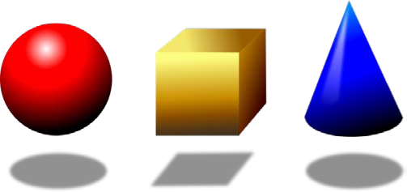
Papers 2 & 3 :
Mathematical Reasoning: 40 minutes
•Solving problems e.g. purchasing things in a shop, or dealing with measurements such as weight or area.
•Geometry and statistics, as well as using arithmetic and number knowledge to solve problems.

Slide 15
Papers 2 & 3 – Mathematical Reasoning – Example Questions
• Starter question: A pack of paper has 150 sheets. 4 children each take 7 sheets. How many sheets of paper are left in the pack?
• Challenging question: One gram of gold costs £32.94. What is the cost of half a kilogram of gold?

Slide 16
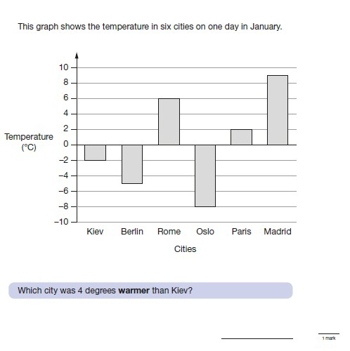
Reasoning – sample question

Slide 17
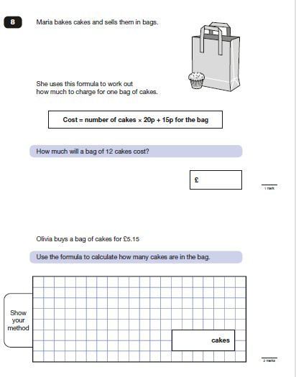
Reasoning – sample question

Slide 18
Marking and Results
Tests will be marked externally by a computer.
Once the results are returned to the school (usually early July), they will be reported to you.
Your child’s score will be converted to a scaled score to allow it to be compared to others’. Scaled scores will normally range between 80 and 120.
The scale will be set so that reaching a score of 100 will indicate that your child is working at the expected standard for the end of Key Stage 2.
Writing and Science are Teacher Assessed.

Slide 19
Higher scores indicates advanced attainment
Lower scores suggests your child may need some additional support to catch up with his or her peers.
Scores will be provided for reading, mathematics, and grammar, punctuation and spelling.
Teacher Assessment will be given in Writing and Science.

Slide 20
How you can help your child achieve well
• Continue the good support you have been giving over the years!
• Please do not become or make your child over anxious and worried that these are life changing exams!
• Avoid the ‘media hype’ and keep your perspective . Stay calm and your child will be calm.

Slide 21
How can I support my child at home?
Time Tables (up to X12)
Arithmetic - for speed
Formal method for the four operations: it is important child can complete methods accurately. (Methods for Year 6 child: column addition, column subtraction, short multiplication, long multiplication, short division, long division including expressing remainders as fractions, decimals and remainder form)
You can also help your child with the standard written methods of calculation.
Support with solving problems in the required steps, including embedding an understanding of estimating and rounding.

Slide 22
^{English support}
Regular reading practice and reinforcing skills
• a)to make deductions and make inferences about the text e.g. “Look at the sentence that begins ‘Once upon a time...’ How does the writer increase the tension throughout this paragraph?”
• b)to provide reasoning for their answers by referring to the text e.g. .......Explain fully, referring to the text in your answer.’
• c)to know how to work out the meanings of words by re-reading the sentence and understanding the context
• d)to understand the intent of the author.

Slide 23
In addition, spelling is now a significant part of the tests, so investigating and learning spelling patterns regularly is useful, as is discussing the use of spellings in the context of a sentence and using strategies such as ‘look, cover, write and check’ when learning spellings. Other strategies include breaking words up into syllables, e.g. important – im-por-tant.
The grammar paper relies on a child knowing the terminology e.g. subordinate clause, main clause, adjective, article, passive, active – and many more, which they should be incorporating in their writing.

Slide 24
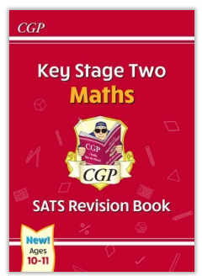
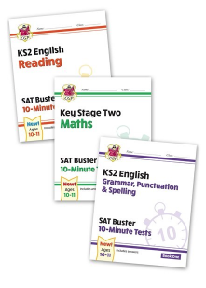
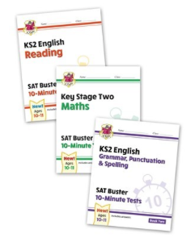
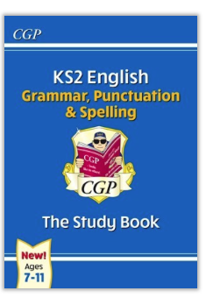
Book | Price | Quantity | Total
Key Stage 2 Maths Study Book | £3.50
Set 1 Set of 3 10 minute revision books on Maths, Reading Comprehension and Grammar, Spelling and Punctuation. | £7.50
Set 2 Set of 3 10 minute revision books on Maths, Reading Comprehension and Grammar, Spelling and Punctuation. | £7.50
Key Stage 2 Grammar, Punctuation and Spelling Study Book. | £3.50
Total enclosed |  |  | £

