Slide 1
Year 4 Multiplication Tables Check (MTC) 2025

Slide 2
Aims of the Session
By the end of this meeting, you will know: all the specific details about the check itself when it will be completed the reporting arrangements school approaches to learning tables how to support at home.

Slide 3
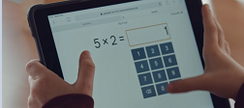
Important information about multiplication tables check (MTC)
The MTC determines if Year 4 children can fluently recall their multiplication tables.
They are designed to help schools identify which children require more support to learn their times tables.
There is no ‘pass’ rate or threshold which means that, unlike the Phonics Screening Check taken in the infants, children will not be expected to re-sit the check.

Slide 4
When the check will take place
In 2025, schools must administer the MTC to all eligible year 4 pupils between Monday 2nd June and Friday 13th June.
Schools can use the following week, Monday 16th June to Friday 20th June, to administer the check to any pupils who were absent during the first 2 weeks or in case of any delays to the administration of the check due to technical difficulties.
There is no set day to administer the check and children are not expected to take the check at the same time.
All eligible Year 4 children in England will be required to take the check.
There is a ‘Try it out’ area, provided by the DfE, which will take place in school.
We are also taking part in the Officially Unofficial MTC on TT Rockstars, which will take place on in Spring Term 1 and Summer 1 (these will be using the Soundcheck game that the children are very familiar with.)

Slide 5
How the check is carried out
The check will be fully digital.
Answers will be entered using an on-screen number pad.
Usually, the check will take less than 5 minutes for each child.
The children will have 6 seconds from the time the question appears to input their answer. (6 seconds per answer means that children must be able to read, recall and enter their response within that time. Whatever is written in the answer box at the end of 6 seconds will be counted as the answer.)
There will be a total of 25 questions with a 3 second pause in-between questions.
There will be 3 practice questions before the check begins.

Slide 6
Specific arrangements for the check
Inclusion
There are several access arrangements available for the check, these can be used to support pupils with specific needs.
Year 4 teachers and Mrs. Naylor will ensure that the access arrangements are appropriate for your child before they take the check in June 2025.
The check has been designed so that it is inclusive and accessible to as many children as possible, including those with special educational needs or disability (SEND). Some arrangements for example include:
Colour contrast
Font size adjustment
‘Next’ button (alternative to 3-second pause)
An adult to input answers

Slide 7
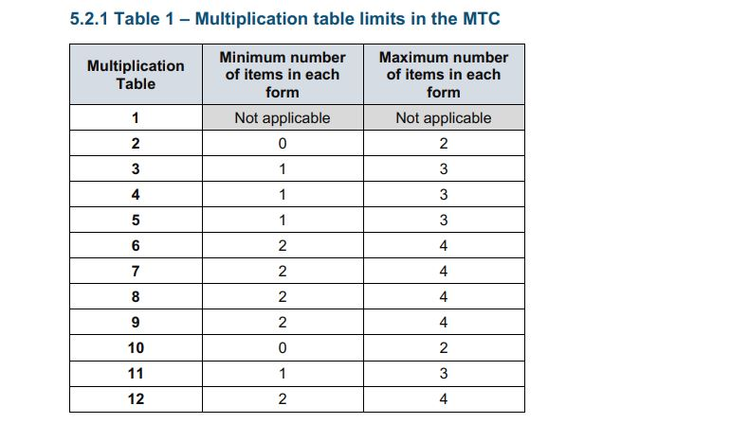
The check questions
Each child will be randomly assigned a set of questions
There will only be multiplication questions in the check, not division facts.
The 6, 7, 8, 9 and 12 times tables are more likely to be asked, as these are the hardest for most children to learn. It’s a good idea to focus on these tricky times tables with your child at home.
Reversal of questions (e.g. 8 x 6 and 6 x 8) will not be asked in the same check.
Children will not see their individual results when they complete the check.

Slide 8
How best to prepare your child for the check
Remind them that the check should last no more than 5 minutes.
If you want to go over times tables, make them fun.
If you have any concerns, talk to your child’s teacher.
If your child has any concerns, encourage them to talk to a trusted adult (for example, yourself, their teacher).
If you’re looking to support your child further with maths at home, there are lots of good websites with free resources, especially TTRockstars which they are use to.

Slide 9
Games to try
Climb the stairs counting in multiples.
Play time tables games verbally.
Listen and sing along to times tables songs.
Take it in turns to say times tables in funny voices.
Play maths games online:
TTRockstars: https://ttrockstars.com/
Hit the Button: https://www.topmarks.co.uk/maths-games/hit-the-button
Timestable games: https://www.timestables.co.uk/games/
Maths frame: https://mathsframe.co.uk/en/resources/resource/477/Multiplication-Tables-Check
Talking Times Tables: https://talkingtimestables.uk/y4_ks2_mtc_practice_tests_multiplication_tables_check.php
U R Brainy: MTC Test - URBrainy

Slide 10
What happens afterwards?
Following the MTC in June, the school will be able to log-in and see each child’s score out of 25.
Children will not ‘pass’ or ‘fail’ the check; it will provide a snapshot of how fluent they are with multiplication facts up to 12 x 12. Following the check, the performance data will be published. The data from the check will be used at school level to identify pupils who may need additional support and intervention in securing their multiplication facts in Upper Key Stage 2 (Year 5 and Year 6).
Year 4 teachers will include your child’s score in their end of Year 4 school report which will be sent home in July 2025.

Slide 11
We really thank you for your support with this matter and wish our Year 4 pupils all the best for the upcoming MTC in June 2025.
Thank for taking the time to come to this evening and reading this information.

