Slide 1
Phonics

Slide 2
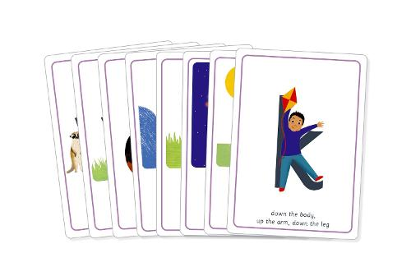
Early Reading Skills
Early reading skills (phonics) are taught in Infant schools and, therefore, as a Junior school, we continue to build on the children's early reading knowledge to ensure they have the right tools and skills they need to enjoy the world of reading. Through a carefully tailored Phonics approach, consistent with the one used at Dinglewell Infant School, we create bespoke provision to close any gaps and accelerate progress for children needing further support.

Slide 3
Essential Letters and Sounds
We use a Department for Education approved systematic synthetic phonics programme called ‘Essential Letters and Sounds’ to build upon the same phonic techniques and skills developed at Dinglewell Infant School. If your child has a need to further develop their phonic knowledge, we will target the missing gaps and put tailored support in place throughout their time at Dinglewell Junior School.

Slide 4
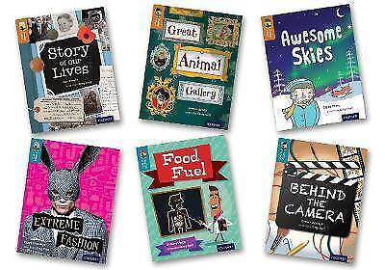
Our Phonic and Reading Ladders
Using discussions and information provided by previous teachers, we will place children onto reading books appropriate for their reading level. We have a very wide range of reading books from decodable books all the way up to level 20. Children reading at this level are ‘Secondary Ready’.

Slide 5
Progression through Levelled Books
As a school, we have decided to keep children on levelled reading books throughout year 3 so that we can carefully monitor reading progress and ensure children can:
read fluently with expression and intonation
use their phonetic code to decode and encode new words
read for meaning to understand what new and unfamiliar words mean
maintain a high level of comprehension to show that they understand what they are reading
Teachers will start to move children who are ready to ‘Free Readers’ in year 4, whilst keeping levelled reading books in place for children needing more structured support and progression to develop their reading.

Slide 6
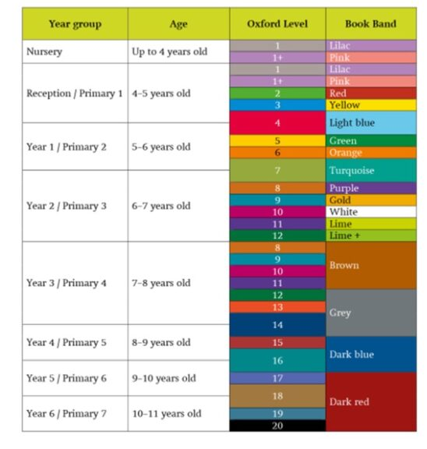

Slide 7
How can I support my child with their phonics?
The most powerful way to support their progression is to read the decodable books sent home at least 3 times a week. Decodable books are specifically matched to meet the phonetic code that your child is able to read and will give them chance to consolidate their learning. You can read through the book more than once – each time it is read fluency will improve. It really will make a difference. If your child gets stuck on a word, model how to say the sounds and blend them together.
Learn how to say the sounds
Use flashcards to help your child practise saying sounds. Use the flashcards to make words for your child to read through blending. These words could be silly or even made up.
Read aloud to your child every day to show them that reading is fun.

Slide 8
Further Support
Bing Videos What is phonics?
Bing Videos How to pronounce pure sounds
Bing Videos How to blend sounds to read words
Bing Videos Phonics help: Top Tips
Bing Videos How to support your child with phonic learning at home
Bing Videos An introduction to Essential Letters and Sounds

Slide 9
Reading

Slide 10
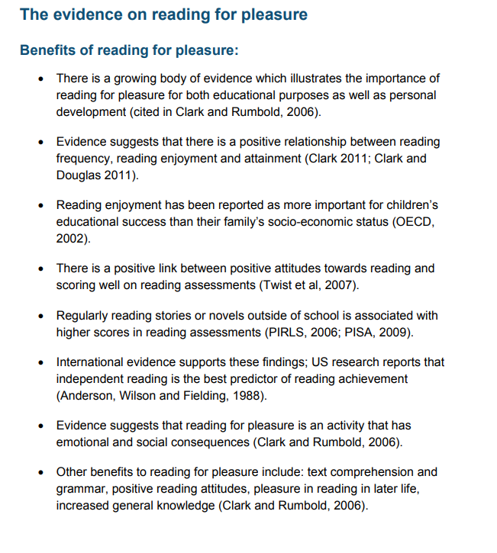
“ Reading enjoyment has been reported as more important for children’s educational success that their family’s socio-economic status.”

Slide 11
Oxford Owl

Slide 12
What are we doing to promote reading?
New reading scheme.
Whole Class Guided Reading – great results!
Author visits – children love these!
Books for Bugs book fair – booked again for March.
Library visits – free books!
Reading Teachers programme.
Newsletter.
Hearing readers – massive task. (Always after volunteers!)

Slide 13
How can you help your child?
Read at least 3 times a week.
We really cannot stress enough the difference you can make to your child’s attainment by doing this.

Slide 14
Lives are busy and technology is a massive part of many children’s lives.
15 minutes – waiting for a sibling/bedtime.
They read to you/you read to them/take turns/echo reading.

Slide 15
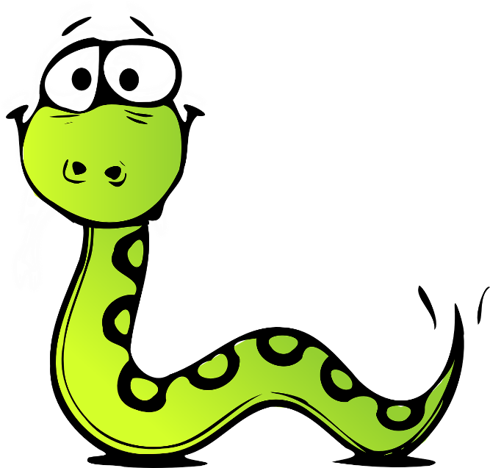
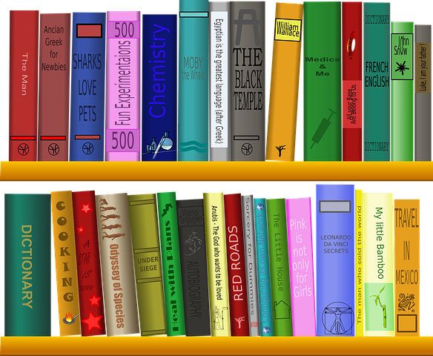
Reading Vipers
Vocabulary
Infer
Predict
Explain
Retrieve
Summarise

Slide 16
Vocabulary
What does ______ mean?
Can you tell me another word that means _____?
Which word tells you that the character is angry?
Which word tells us something bad is about to happen?
Which word in this section do you think is the most effective in building the suspense?

Slide 17
Inference
To ‘infer’ is to find meaning that is not made explicit in the text.
“Her palms were sweating and her heart was racing.”
Why was the character feeling happy?
Why did the character run away?
What kind of person is _____? How does the author show that?
How can you tell the animal is in pain?
How can you tell this house has not been looked after?
How is the character feeling? How do you know that?
What impression do you get of this setting?

Slide 18
Prediction
The emphasis here is not to necessarily be right – if all books were predictable, that could become very dull!
Look at the cover. What do you think this book will be about?
What do you think will happen next? What makes you think this?
Do you think they will be successful in their quest? Why / why not?
How do you think the character is going to react? Why do you think that?
Look at the chapter title. What do you think might happen?

Slide 19
Explain
Children are encouraged to explain their preferences, thoughts and opinions about a text.
Who is your favourite character? Why?
Would you like to live in this setting? Why / why not?
Is there anything you would change about this story?
How does the author build up the tension here?
Why do you think the author doesn’t name the villain yet?
Why has the text been arranged in this way

Slide 20
Retrieve
This skill concerns finding and recording information located in the text. However, the challenge can lie in children having to skim back over large quantities of text.
In what year did the astronauts land on the moon?
What did the parents decide to name their baby?
Who was the first character to climb on the boat?
Give an example of one of the grandmother’s warnings.
Where did the squirrel hide the food?
What were the three things Bob was asked to pack?

Slide 21
Sequence/Summarise
Children are taught to recap the events of a narrative and put them in order (sequence) or sum them up (summarise).
How did the story start?
What happened next?
Number these events 1 – 5.
Can you summarise the story so far?
What happened in the story so far?
How has the character’s life changed throughout this book?

Slide 22
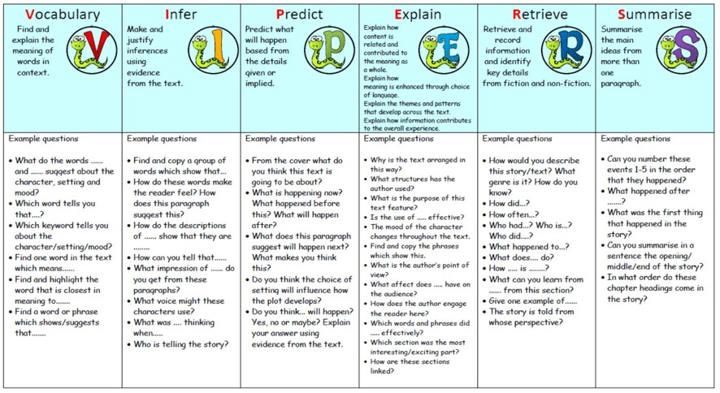

Slide 23
Why aren’t we rushing them to be Free Readers?
How to choose texts:
The Reader Teacher | Children's Books | Reads, Reviews & Recommendations
Best children's books - Year Group Recommended Reads (booksfortopics.com)
Buy Used Children's Books Cheap | Page 1 | World of Books (wob.com)
Search for a Book | Gloucestershire County Council

Slide 24
Events to Inspire:
What's on | Cheltenham Festivals

Slide 25
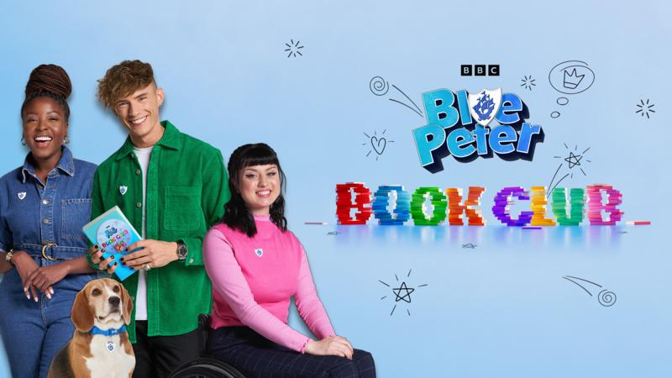

Slide 26
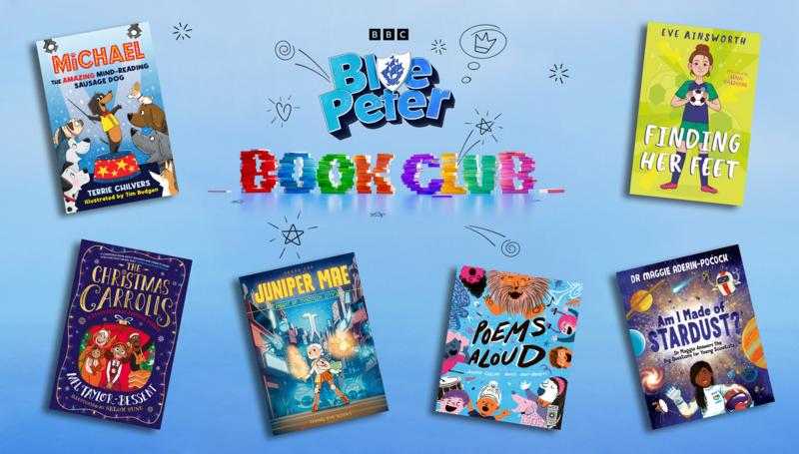

Slide 27
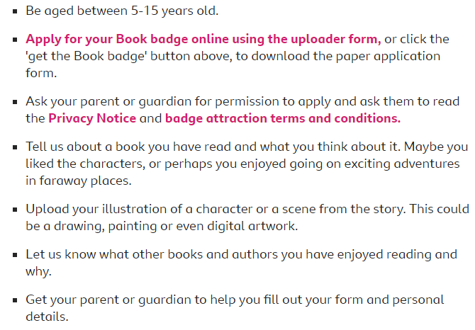

Slide 28
Maths The Maths information from this evening can be found in the DJS Calculation Policy booklet on the school website. Click on Key Information Tab, then Policies.

